Slide 1

CYBR 7910: Capstone Project
Group 4: Gevorges Chenmala, Masrura Tasnim, Richard Beiswanger, & Uju Anachebe

Slide 2

Objective
The main objective for this Capstone Practicum Team Project is gain experience practicing the skills we learned throughout the Cybersecurity Masters Program by emulating a real-world scenario configuring cybersecurity protections on a small company webserver, implementing both defensive blue-team protections and red-team vulnerability assessments/penetration tests.

Slide 3
Meet The Team
Roles | Name | Major Responsibilities
Team lead / CISO | Richard Beiswanger | Project Plan & Presentation Lead
Cyber Analyst | Uju Anachebe | Phase 1 Lead, Author & Presenter
Cyber Engineer | Masrura Tasnim | Phase 2 Lead, Author & Presenter
Penetration Tester | Gevorges Chemmala | Phase 3 Lead, Author & Presenter

Slide 4

Background
We are Cyberguardian Solutions, a cybersecurity consulting company hired by the small-business Caribbean-inspired steakhouse, Akwaaba. Our mission is to protect their e-commerce web server by performing blue and red-team tasks in this real-world scenario. The entire project was completed within a 7-week timeframe from start to finish. To manage this project, we broke it down into 5 manageable milestones:

Slide 5

Deliverable #1: Project Plan
Lead by Richard Beiswanger, the first milestone was project planning, where we created a detailed project plan, including team roles, communication strategies, and a breakdown of the project deliverables into milestones, accompanied by a Gantt chart updated throughout the project.

Slide 6

Deliverable #2: Security Assessment/Policy
Led by Uju Anachebe, Milestone 2 involved preparing and submitting a comprehensive report detailing our developed defensive security program, including an information security policy, risk assessment, and a technical plan for protecting Akwaaba's web server.

Slide 7

Deliverable #3: Security Implementation & Exploit Planning
Led by Masrura Tasnim, for Milestone 3 we provided a report showing how we implemented the security program designed in the previous phase and made plans for the next phase where we perform vulnerability analysis/penetration tests of another team's VM.

Slide 8

Deliverable #4: Pen-Testing & Security Ops
Led by Gevorges Chemmala, at this milestone we reported our findings from the vulnerability exploitation assessment of another team's server, delivering our results to the target while receiving a similar report from them for our own self-reflection. We also recorded the results from defensive security operations while our server was penetration tested.

Slide 9

Deliverable #5: Presentation Summary
Led by Richard Beiswanger, Milestone 5 is this final presentation briefly summarizing the results of all previous milestones. Here we reflect on the security program's effectiveness with a recorded presentation. Included in this milestone are the Peer Evaluations, which were completed before the same deadline.

Slide 10

Relevant Technologies & Products
This scenario was conducted on a Red Hat Linux webserver running a WordPress website using Apache and MariaDB. We conducted pentests from a Kali Linux system on Virtual Box, protecting the system and conducting scans and tests using various Cybersecurity tools including: Wpscan, Nmap, Burp Suite, Wazuh, OpenVAS, Metasploit, Nikto, SQLmap, linPEAS, GoBuster, CUPP, XSSer, Fail2Ban, SELinux and Mod Security.

Slide 11
Security Policies
General Security Policies
Internet Access & Usage Policy
Email Policy
Bring Your Own Device (BYOD) Policy
Software Installation Policy
Access Management Policy
User Access
Authority Levels
Access Control Measures
Maintenance and Configuration
Access Control Principles
Physical Access Control

Slide 12
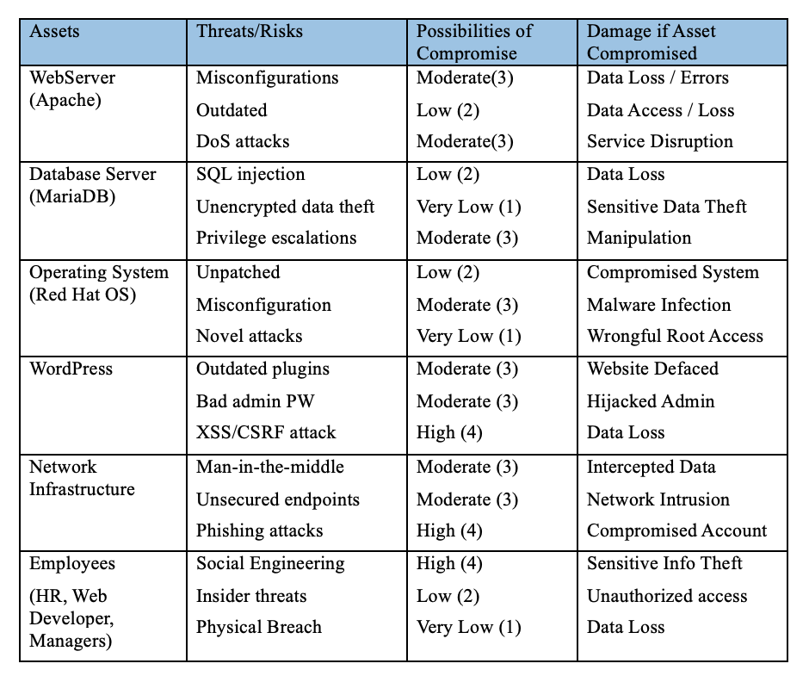
Risk Assessment

Slide 13
Technical Plan
Security Enhancement Strategies
Uphold tight privilege guidelines
Schedule regular patches and updates
Encrypt sensitive data in transit
Recommend a recovery strategy
Security Tools
Fail2Ban
Nmap
Wordfence
WPScan
Gobuster

Slide 14

Phase 2 Progress Update
From Blueprint to Reality
Credential Setup and Security Updates
Strategic Tool Deployment
Phase 3 Preparedness
Collaboration and Adaptive Planning

Slide 15

Introduction
Security Implementation Overview
Critical Security Tools Utilized
Vulnerability Analysis Approach
Proactive Defense Tactics

Slide 16
Building a Defense for the VM
Goal-Oriented Security Architecture
Explored cyber threats and vulnerabilities.
Developed a secure IT environment, safeguarding against unauthorized access.
Foundational Security Steps
Updated system software and established automated update protocols.
Configured SELinux policies to enable necessary WordPress updates.
Comprehensive Tool Deployment
Introduced tools such as Nikto, Gobuster, Nmap, and WPScan for prevention, detection, and response.
Chose tools compliant with cybersecurity best practices.
Key Security Configurations
Leveraged Let’sEncrypt initially, then switched to self-signed certificates for HTTPS setup.
Configured UFW to serve as a primary network traffic gatekeeper.
Tailored Fail2Ban settings to deter brute force attacks.

Slide 17
In-Depth Look at Our Security Analysis
Security Enhancements and Troubleshooting
Proactive Protective Measures
Advanced Security Instruments
Continual Vigilance and Monitoring

Slide 18
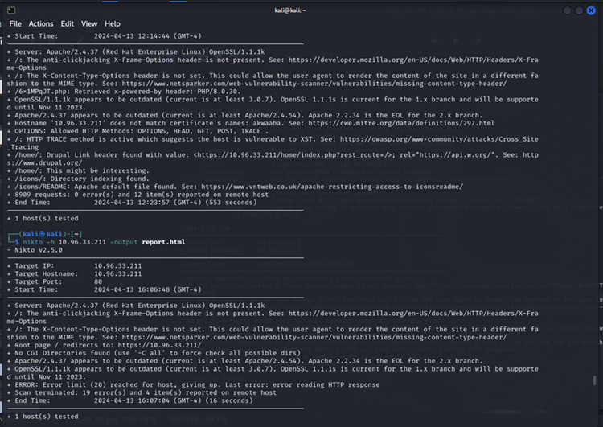
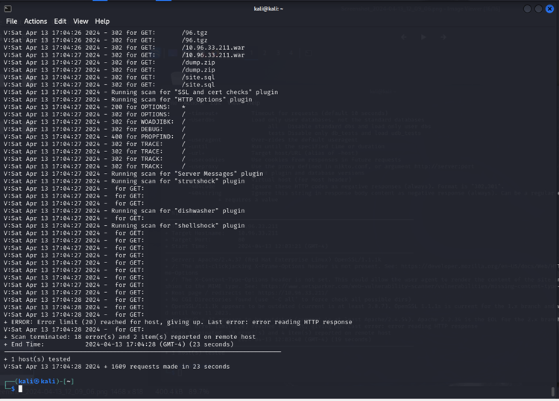
Efficient Vulnerability Scanning with Selected Tools
Nikto Installation & Initial Scanning
Installation & Verification
Database Update
HTTPS Protocol Scanning
Report Generation
Redirect Handling
Verbose Output

Slide 19
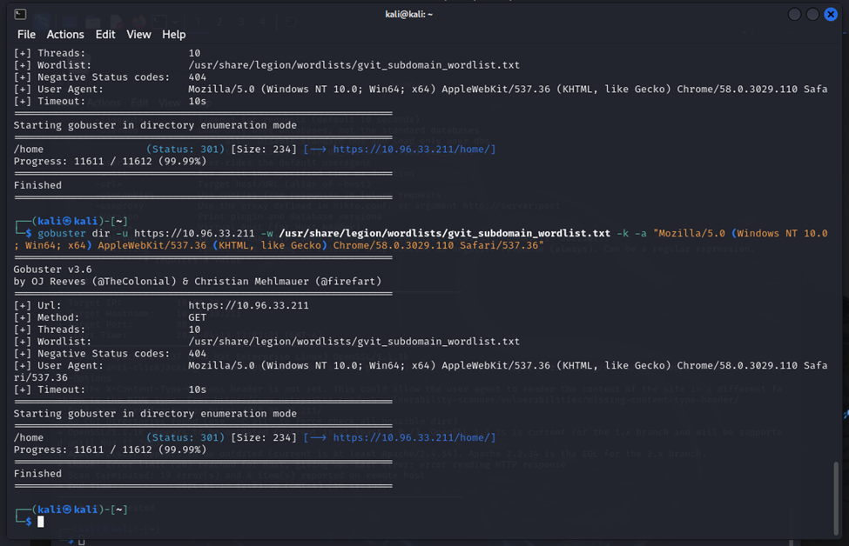
Efficient Vulnerability Scanning with Selected Tools
Gobuster Setup & Configuration
Installation Process
Directory Enumeration
Optimization
Sample Command Execution

Slide 20
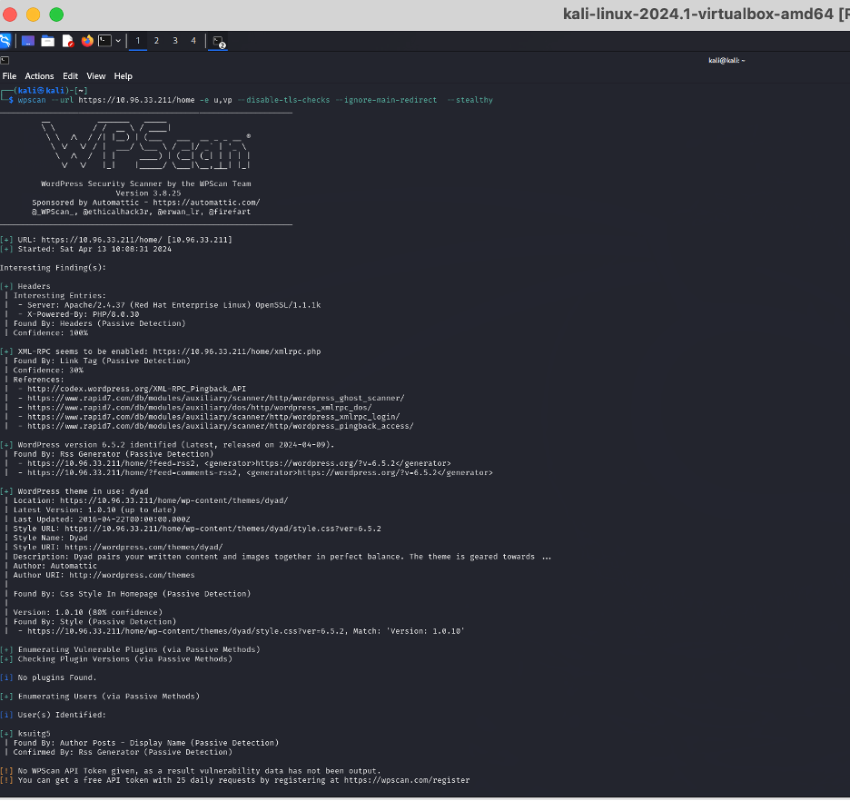
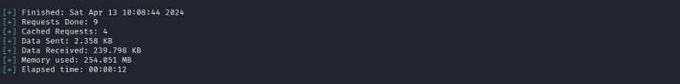
Efficient Vulnerability Scanning with Selected Tools
WPScan for WordPress Vulnerability Detection
Pre-Installed Tool Utilization
Ran WPScan after updating with wpscan --update.
Command for Targeted Scanning
Executed WPScan with flags to explore vulnerabilities and user enumeration.
WPScan Findings Overview
Provided insights into secure configurations and potential XML_RPC exposure.
No vulnerable plugins found, and user enumeration was successful.

Slide 21
Vulnerability Analysis and Penetration Testing Strategy
Nmap - The Network Discovery Tool
Tool Introduction
Nmap: Versatile network scanning tool for security audits and network exploration.
Usage and Benefits
Identifies active devices on the network, open ports, and service details.
Chosen for its user-friendly approach to revealing the services running on our server.
Strategic Application
Nmap's findings guide the tightening of network security and shaping of firewall rules.
OpenVAS - In-Depth Vulnerability Assessment
Tool Overview
OpenVAS: Robust vulnerability scanner with a vast database of known exploits.
Selection Justification
Preferred for its accurate security assessments backed by frequent updates.
Customizable scan options align with our VM's specific security context.
Reporting Features
Delivers detailed vulnerability reports, offering actionable insights.

Slide 22
Vulnerability Analysis and Penetration Testing Strategy
Metasploit - Targeted Exploitation
Tool Functionality
Rationale for Selection
Integration and Execution
OWASP ZAP - Proactive Web Defense
Security Tool Capabilities
Reasons for Choice
Report Generation

Slide 23
Vulnerability Analysis and Penetration Testing Strategy
XSSer and Burp Suite - Advanced Threat Detection
XSSer
Burp Suite
Strategic Selection

Slide 24

Cybersecurity Phase 3 Milestone
Richard Beiswanger
Uju Anachebe
Masrura Tasnim
Gevorges Chemmala

Slide 25

Cybersecurity Phase 3 Milestone
The Red Team was responsible for assessing the vulnerability of the target team's system, conducting pen-testing to simulate real time attack on the target server.
The Blue Team was responsible for monitoring, taking incident response action and forensic analysis of our team's server.

Slide 26

Vulnerability Analysis & Pen-Testing tools
We planned to use the following tools for vulnerability analysis and penetration testing on target systems.
Nmap to scan open ports on the server, identify OS, Services, Application, and its versions.
WPScan and OWASP ZAP, to identify vulnerabilities on WordPress, its plugin and themes.

Slide 27

Vulnerability Analysis & Pen-Testing tools
OpenVAS and Metasploit to identify vulnerabilities on the target system.
SqlMap for SQL Injection test.
XSSer for testing XSS vulnerabilities
Gobuster brute forcing directories on web servers.

Slide 28
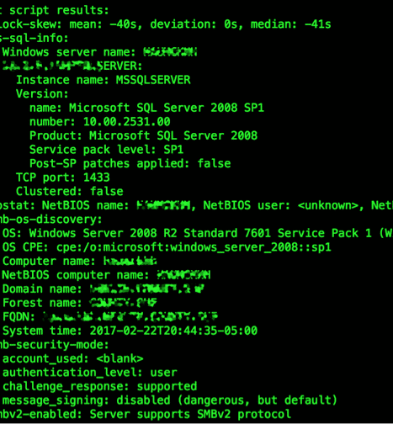
Vulnerability Analysis & Pen-Testing tools
Burp Suite to track and intercept HTTP/HTTPS traffic and for obtaining target URLs for SqlMap, Gobuster, XSSer.
John the Ripper and Hashcat used crack passwords from hash values.

Slide 29
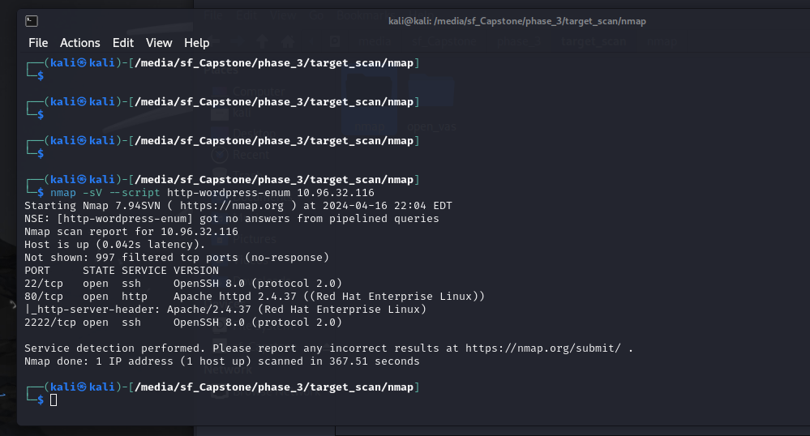
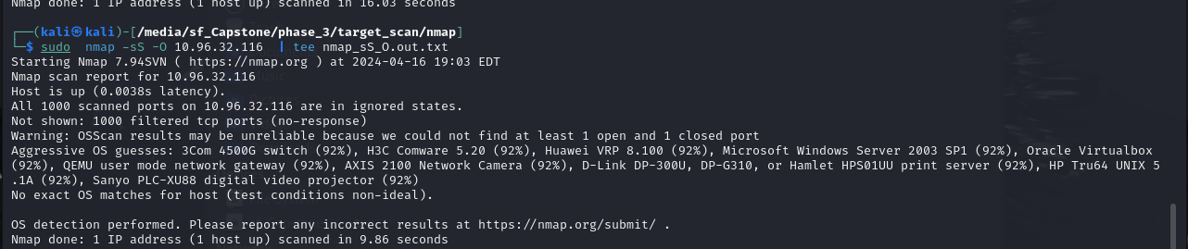
Nmap - Analysis report
Open ports : 22 ssh; 80 http, 2222 ssh
Nmap reported Oracle Virtualbox was one of the possible OS among the list of target machine OS.
While conducting scanning, it seems KSU Network was blocking our traffic in the network.
Nmap did not find HTTPS on the server; all traffic to the site was unencrypted.

Slide 30
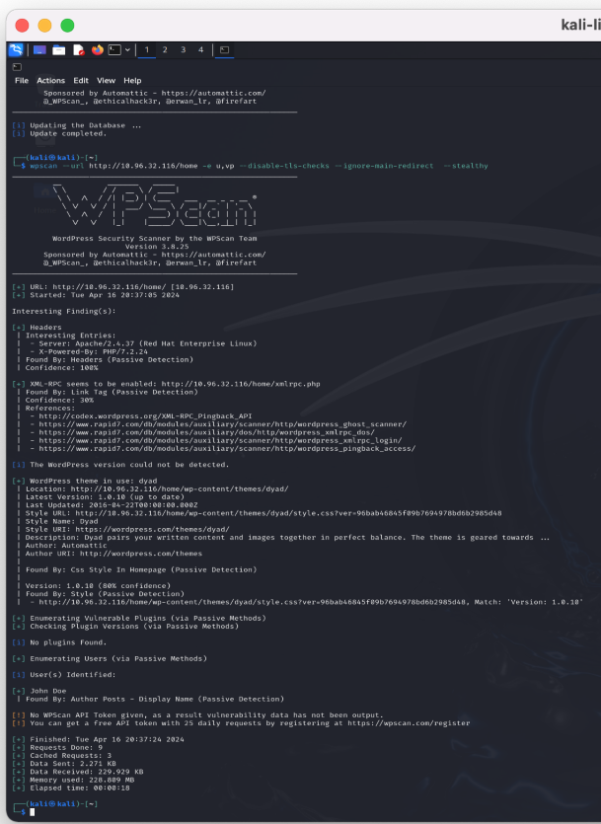
WPScan - Analysis report
WPScan reported use of Apache/2.4.37 (Red Hat Enterprise Linux) with PHP/7.2.24
XML-RPC seems to be enabled.
WordPress theme Dyad, Version: 1.0.10 was found.
And identified one user John Doe

Slide 31
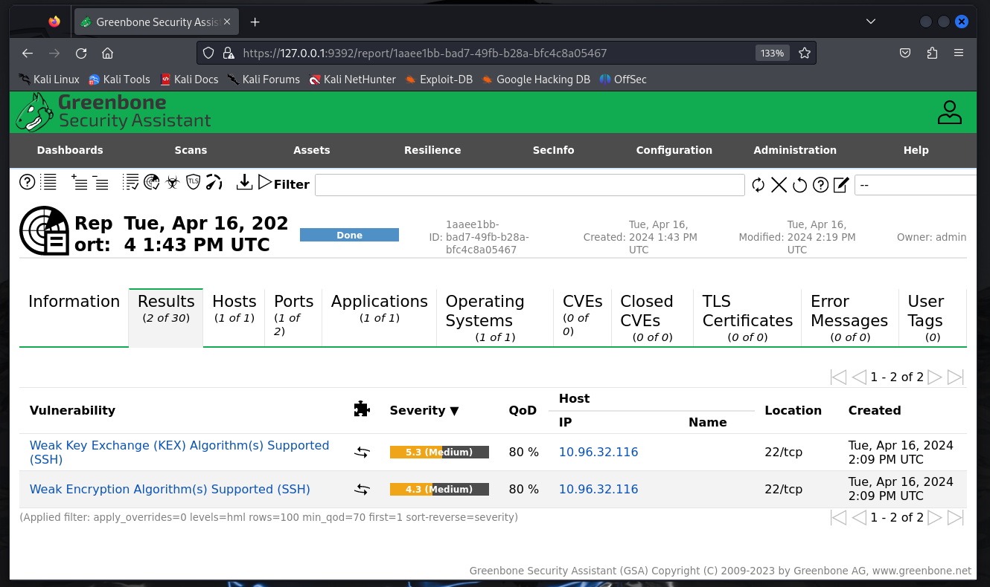
OpenVAS - Analysis report
The remote SSH server was found allowing support for weak key exchange (KEX) algorithm diffie-hellman-group-exchange-sha1 | Using SHA-1
As well as weak client-to-server and server-to-client encryption algorithms aes128-cbc and aes256-cbc

Slide 32
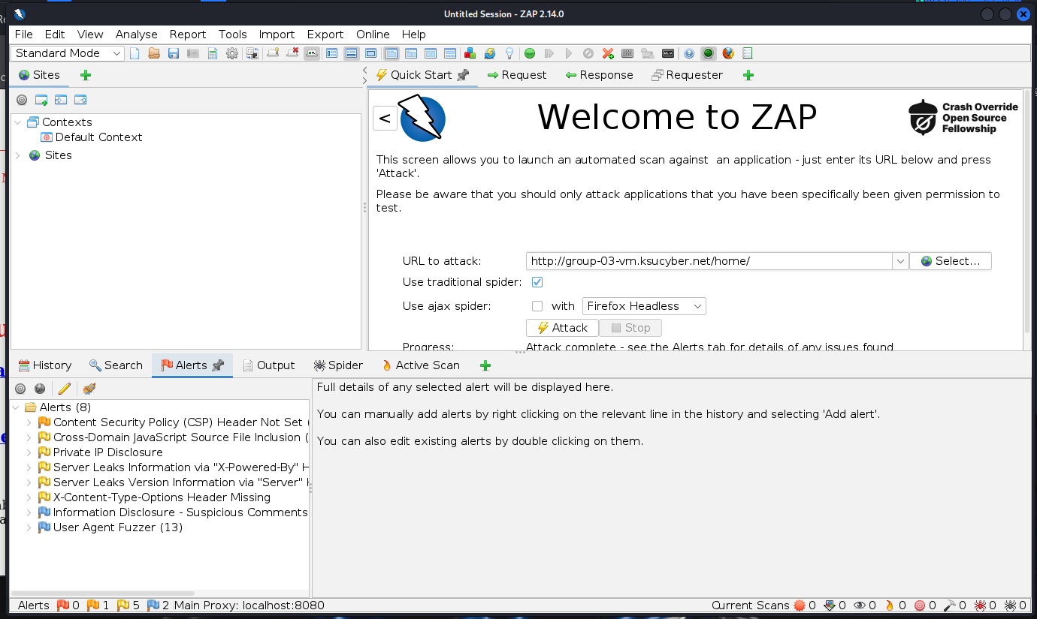
OWASP ZAP - Analysis report
Content Security Policy (CSP) Header Not Set
Cross-Domain JavaScript Source File Inclusion
Private IP Disclosure
Server Leaks Information via "X-Powered-By" HTTP Response Header Field(s)
Server Leaks Version Information via "Server" HTTP Response Header Field
X-Content-Type-Options Header Missing
Information Disclosure - Suspicious Comments
User Agent Fuzzer

Slide 33
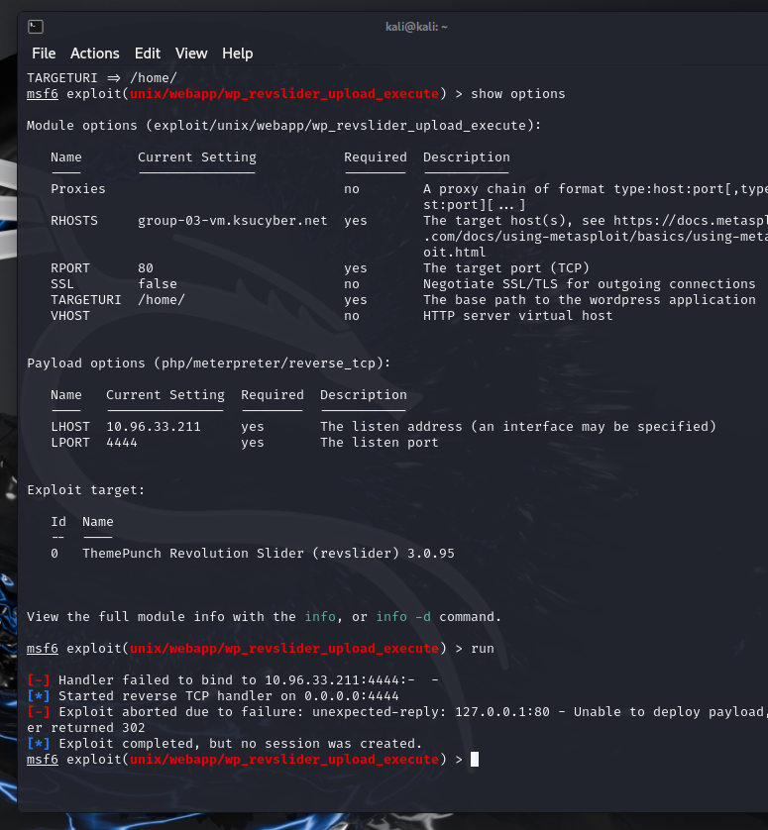
Metasploit- Analysis report
KSU Network was banning our traffic when we started scanning. So, what we could do was limited.
Our attempt to run exploits were not successful.

Slide 34
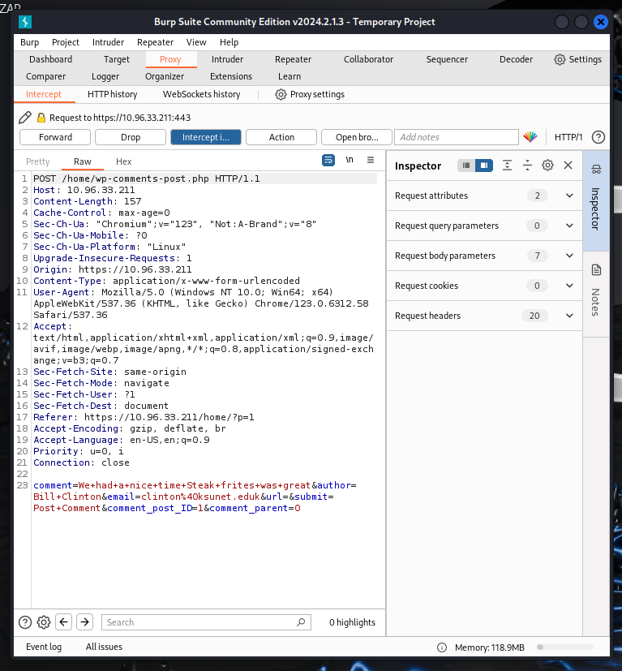
Burp Suite - Analysis report
We analyzed traffic with Burp Suite.
Target site did not have form submission.
An attempt was made to submit form data using a guessed, URL But the attempt was unsuccessful.

Slide 35
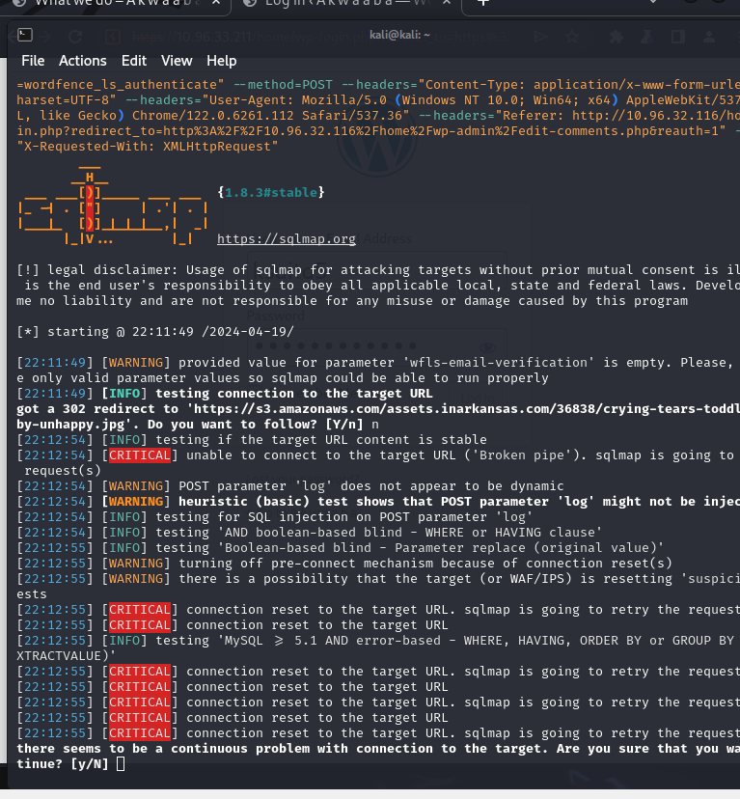
SqlMap - Analysis report
There seems to be no form submission and login feature for the public.
An attempt was made to submit form data using a guessed, URL But the attempt was unsuccessful.

Slide 36
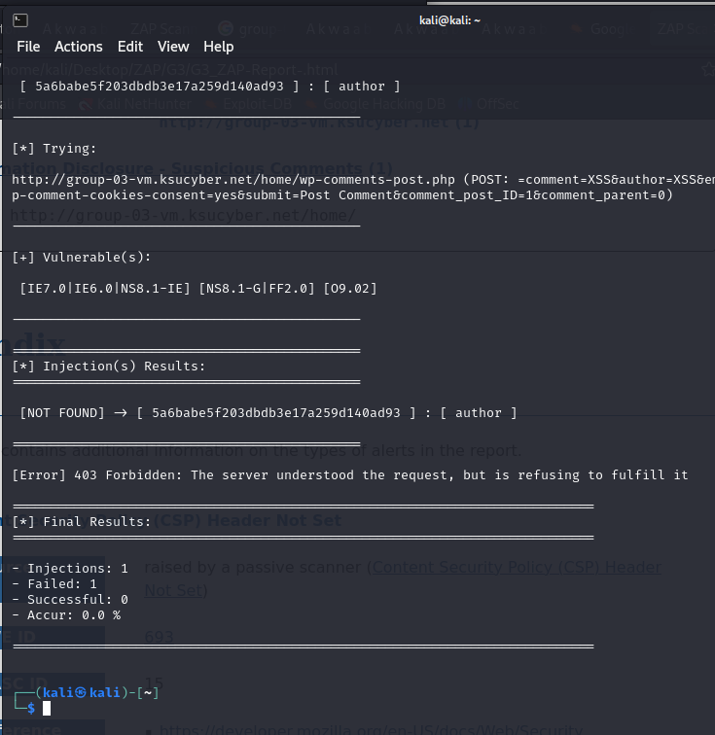
XSSer - Analysis report
There seems to be no form submission and login feature for the public .
An attempt was made to submit form data using a guessed URL.
But the attempt was unsuccessful.

Slide 37
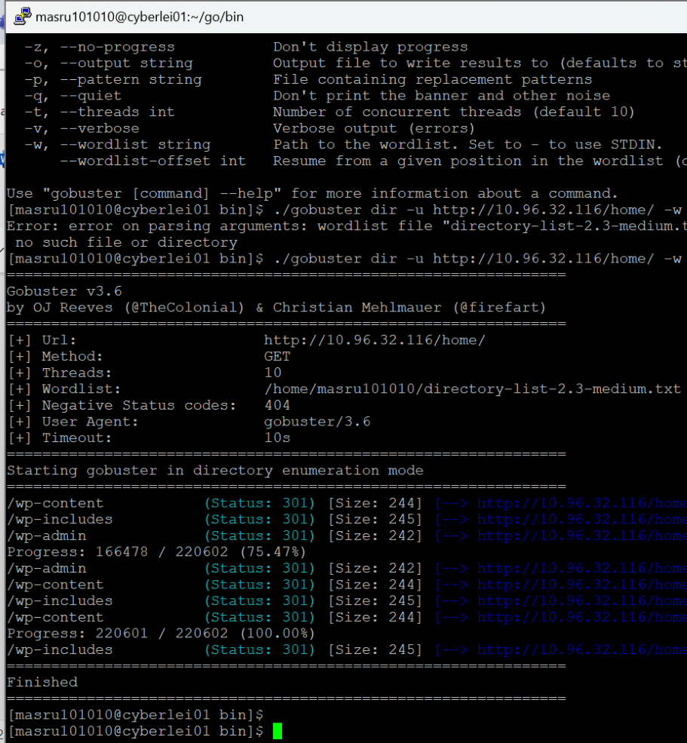
Gobuster - Analysis report
Gobuster revealed we can do directory surfing and obtain sensitive contents.
/home/wp-includes/
/home/wp-admin/js/
/home/wp-content/ /home/wp-content/uploads/
The website disabled right click context menu, thus affecting accessibility and usability of the site. This don't protect its content as all those data is accessible though developer console of the visitor's browser. As well as available through directory browsing.

Slide 38
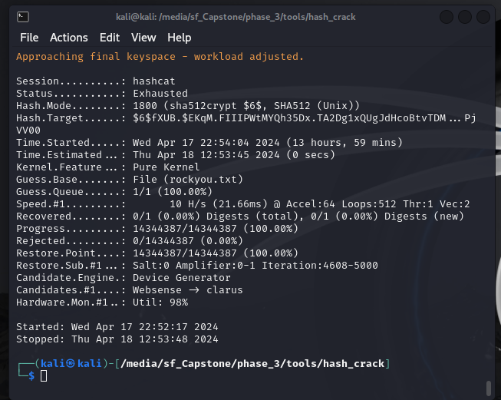

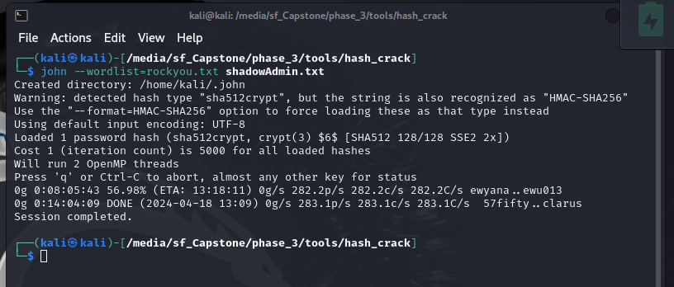
John the Ripper & Hashcat
We tried to crack password hash for user id named administrator to try the same at the target server.
But we was unsuccessful in obtaining password

Slide 39

Blue Team Activity
Our Blue Team acted as the IT security team responsible for defending the server by actively monitoring and responding to security incidents.
Defending against attacks
Identifying and mitigating vulnerabilities
Implementing security controls
Response to incidents

Slide 40

Blue Team tools
As mentioned earlier, to protect and monitor the system blue team used:
SELinux,
ssh, fail2ban, firewall-cmd
https, SSL, .htacces
Wazuh
Wordfence
Other Linux utilities

Slide 41
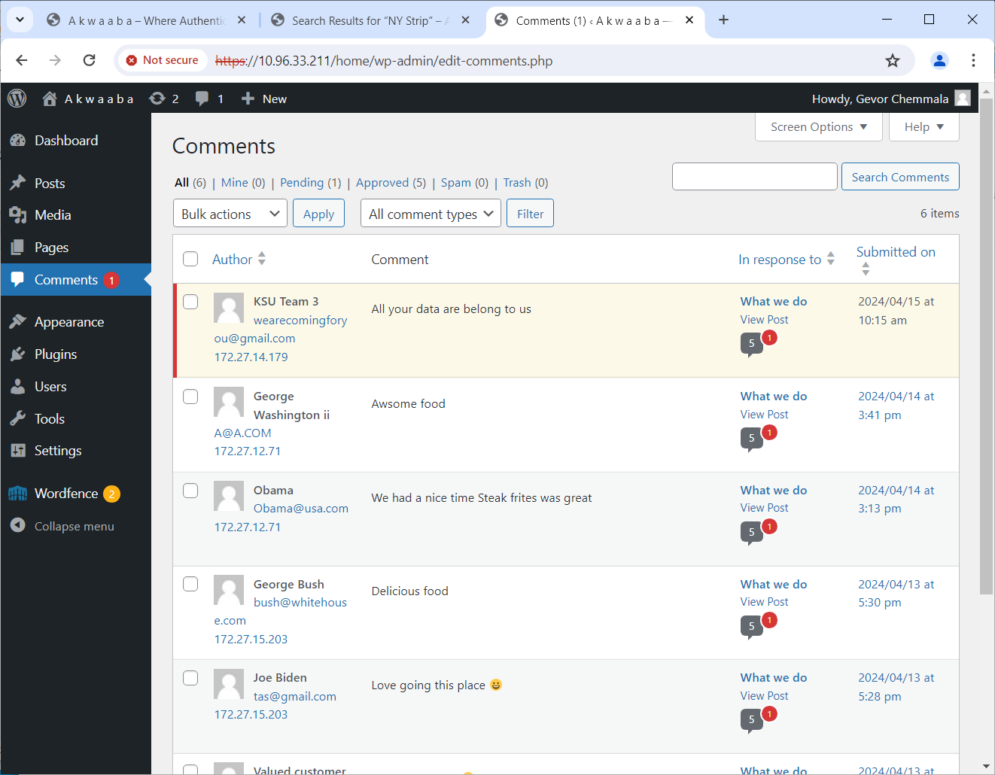

Wordfence Security Plugin
Two factor authentication was enabled and mandatory for all administrator user id, hence login was protected.
Spam filtering was enabled.
Spam filter caught a spam and was threshed.

Slide 42
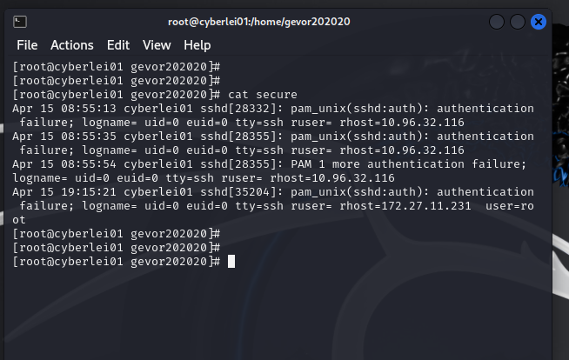

Fail2Ban for SSH Protection
We noticed failed login attempts from two separate IP address.
It appeared to be triggered using a tool.
Fail2Ban caught both cases and jailed the IP address.

Slide 43

RedHat firewall-cmd
Firewall was configured to only expose ports
22 (ssh)
80 (http)
443 (https)
Wazuh Dashboard and Database access was limited to ssh users.

Slide 44

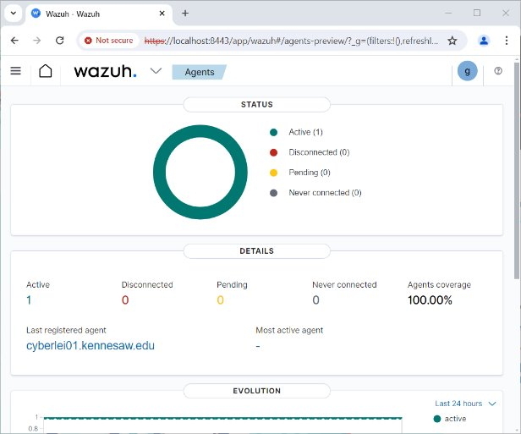
Monitoring with Wazuh
Continuous monitoring with Wazuh was enabled.
Wazuh tracked activities on the server.

Slide 45
Project Experiences

Slide 46
Project Experiences

Slide 47
Project Experiences

Slide 48
Future Work

